Slide 1

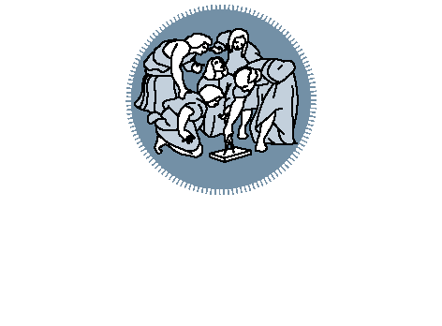
Titolo presentazione sottotitolo
P2P with Chord
Distributed System Project | PoliMi
29th March 2019
Giuseppe Severino, Marco Mussi
Milano, XX mese 20XX

Slide 2
Design Choices
Number of bits in the key/node identifier m = 32, chosen in order to make the probability of two nodes or keys hashing to the same identifier negligible (2³² different IDs)
Consistent hashing is implemented by assigning each node and key an m-bit identifier using SHA-1. It is obtained by hashing the node’s IP and Port address for the node, while a key identifier is produced by hashing the key (as specified by the original paper)
Adoption of the socket protocol to handle the communications between nodes
Giuseppe Severino, Marco Mussi

Slide 3
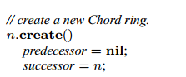
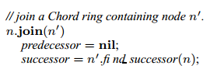
Client Class
It asks to the user to select the operation to perform:
Create
Input: local destination port
Output: the node is added to a new Chord ring
Join
Input: local destination port + ip and
port of the chord ring to connect to
Output: the node is added to the specified Chord ring
Search
Input: ip and port of a chord node + the key to search
Output: the node in which the key is contained
Giuseppe Severino, Marco Mussi

Slide 4
Node Class
It contains all the characteristics of a Chord node
The Finger Table of a node is stored in an HashMap
Each node keeps track of its successors with an ArrayList of size 32, in order to handle the failures in the ring
It implements the findSuccessor and the closestPrecedingNode methods
The following threads are started after the node initialization:
Listener
Stabilize
FixFinger
CheckSuccessor
Giuseppe Severino, Marco Mussi

Slide 5
Listener Thread
Is an always active ServerSocket that accept request from the network
It creates a new ManageRequest thread for every incoming request
The ManageRequest thread analyze the received object, understand the request type and sends the response to the sender coherently
Giuseppe Severino, Marco Mussi

Slide 6
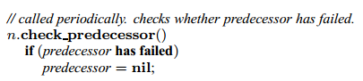
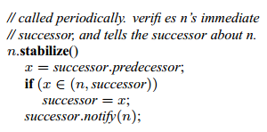
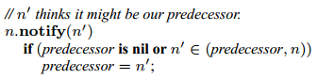
Stabilize Thread
This thread checks periodically if the predecessor has failed, verifies the node immediate successor and tells the successor about the existence of the current node. At the end, a notify message is sent to successor.
Giuseppe Severino, Marco Mussi

Slide 7
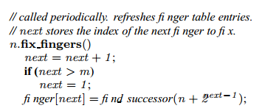
Fix Finger Thread
This thread checks periodically the entries of the finger table, to make sure they are correct
Giuseppe Severino, Marco Mussi

Slide 8
Check Successor Thread
This thread checks periodically if the successor is still alive. If a node’s immediate successor does not respond, the node can substitute the second entry in its successor list
Giuseppe Severino, Marco Mussi

Slide 9
Request
The Request class is an abstract class used for all the socket communications through the nodes. This class is implemented by the concrete subclasses. They are:
CheckStatusRequest
GetPredecessorRequest
GetSuccListRequest
NotifyRequest
UpdateSuccessorListRequest
Giuseppe Severino, Marco Mussi

